Slide 1
Learning Analytics
Student Performance Dataset (Mini-Project)
Data Science and Artificial Intelligence SC1015 (SC7)
Alan Wong U2121088B
Keith Ang U2121419F
Mavis Khoo U2121376B

Slide 2
Overview
Descriptive Analytics
Data Breakdown
EDA - Clustering
Predictive Analytics
Decision Tree
Prescriptive Analytics
What can be done

Slide 3

Problem Definition
What are some factors affecting learning?
Learning Analytics - Collection and analysis of data about learners and their environments for the purpose of understanding and improving learning outcomes

Slide 4
Description of Dataset
Student Performance Dataset from Paulo Cortez and Alice Silva (2005-2006)
Qualitative and Quantitative analysis
Derived from Paper Reports and Questionnaires
Notes:
This study will consider data collected during the 2005- 2006 school year from two public schools, from the Alentejo region of Portugal. Although there has been a trend for an increase of Information Technology investment from the Government, the majority of the Portuguese public school information systems are very poor, relying mostly on paper sheets (which was the current case).
Hence, the database was built from two sources: school reports, based on paper sheets and including few attributes (i.e. the three period grades and number of school absences); and questionnaires, used to complement the previous information. We designed the latter with closed questions (i.e. with predefined options) related to several demographic (e.g. mother’s education, family income), social/emotional (e.g. alcohol consumption) (Pritchard and Wilson 2003) and school related (e.g. number of past class failures) variables that were expected to affect student performance. The questionnaire was reviewed by school professionals and tested on a small set of 15 students in order to get a feedback. The final version contained 37 questions in a single A4 sheet and it was answered in class by 788 students. Latter, 111 answers were discarded due to lack of identification details (necessary for merging with the school reports). Finally, the data was integrated into two datasets related to Mathematics (with 395 examples) and the Portuguese language (649 records) classes. During the preprocessing stage, some features were discarded due to the lack of discriminative value. For instance, few respondents answered about their family income (probably due to privacy issues), while almost 100% of the students live with their parents and have a personal computer at home. The remaining attributes are shown in Table 1, where the last four rows denote the variables taken from the school reports.

Slide 5
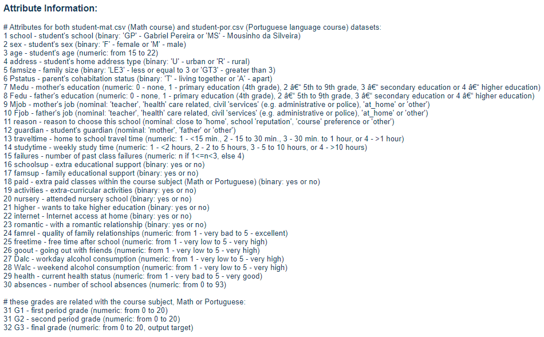

Slide 6
Dataset Characteristics (33 Variables)
6 Numerical Data (Quantitative)
(age, absences, failure, G1, G2, G3)
4 Nominal Data (Categorical)
(Mjob, Fjob, reason, guardian)
1
2
3
10 Ordinal Data (Qualitative)
(Medu, Fedu, traveltime, studytime, famrel, freetime, goout, Dalc, Walc, health)
4
13 Binary Data (Categorical)
(school, sex, address, famsize, Pstatus schoolsup, famsup, paid, activities, nursery, higher, internet, romantic)
Notes:
The dataset is split into 4 different categories, numerical, nominal, ordinal and binary.

Slide 7
Response Variable identified
For this research, G3 is the response variable.
Environmental variables provide insight on how G3 is affected.
G1 and G2 act as validation for such lifestyle.
*This paper assumes that lifestyles are consistent and recorded before G1, G2 and G3

Slide 8
Data Preparation
There are no missing values and outliers will be kept as they would provide meaningful information when doing this research.
Relevant in Learning Analytics where anomalies are prominent.
Notes:
(One-hot)
Changing data type to fit tools

Slide 9
One-Hot Encoding (Model Building)
Nominal variables cannot be ordered in a meaningful way
Convert each value in nominal variable into a binary variable
Eg. Mjob - Health, Services, At home etc.
Mjob
Health
Services
At_Home
Mjob_Health | Mjob_Services | Mjob_At_Home
1 | 0 | 0
0 | 1 | 0
0 | 0 | 1
Notes:
The DT cannot work with predictors that consist of different data types. For nominal variables with object as data type, they cannot be ordered in a meaningful way. Hence, we are unable to standardise all the variables by simply converting these nominal variables into integer data type. One-hot encoding is used to add a binary variable for each unique value in each nominal variable.

Slide 10
Descriptive Analytics
(Correlation)

Slide 11
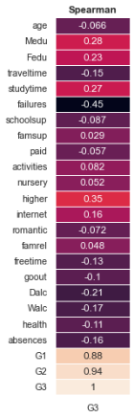
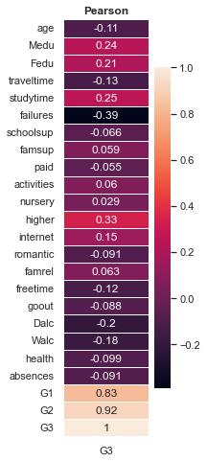
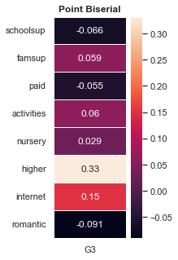
Spearman VS Pearson VS Point Biserial
Notes:
Spearman correlation coefficient is often used to evaluate relationships involving ordinal variable (Continuous - Ordinal)
Pearson correlation coefficient is used when you want to see if there is a linear relationship between two quantitative variables. (Continuous - Continuous)
We use this biserial method to validate that the binary correlations are correct. We use point biserial correlation when one variable is continuous (G3) and the other is nominal with just two categories (binary variable).

Slide 12
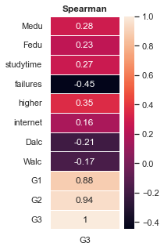
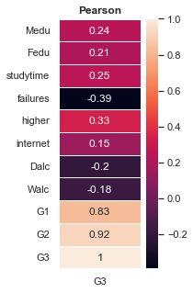
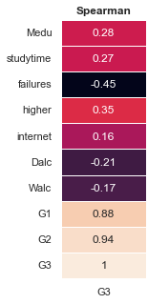
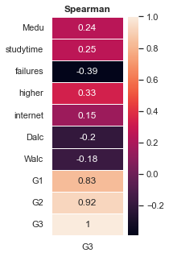
Main Variables
Notes:
The correlation for ordinal data (traveltime & studytime) , continuous data (G1 & G2) and binary data (higher & internet) derived from the three different methods did not show a significant difference.

Slide 13
Descriptive Analytics
(Clustering)

Slide 14
KMeans vs Hierarchical vs KPrototype
Aggregated clustering vs density-based clustering
Allows detection of structure
KMeans - Fast but inaccurate (Numerical)
Hierarchical - Accurate but take longer time (Numerical)
KPrototype - Similar to KMeans (Numerical & Categorical)
Notes:
KMeans → Fast in implementing but we have to manually select how many groups/clusters there are.
Hierarchical → Does not need us to specify number of clusters, is not sensitive to the choice of distance metric but has a higher time complexity
KPrototype → Similar to Kmeans and is more suitable for mixed data as it also measures the distance between categorical features and numerical features
We use Kmeans and Hierarchical to compare both clustering on numerical values to see the number of clusters formed is similar. We used KPrototype as it is most suitable for both Numerical & Categorical Value.

Slide 15
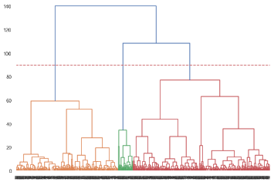
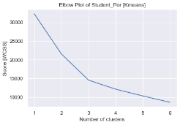
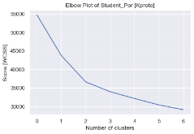
KMeans
(Elbow Plot)
Hierarchical Clustering (Dendrogram)
KPrototype
(Elbow Plot)
Notes:
We use elbow plot to determine how many clusters are needed for Kmeans and Kprototype based on density.

Slide 16
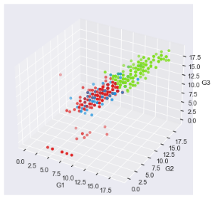
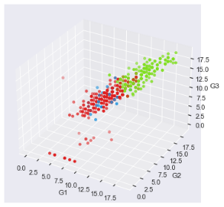

Clustering Comparison for G1-G3 (Test Scores)
KMeans Clustering
Hierarchical Clustering
KProto Clustering

Slide 17
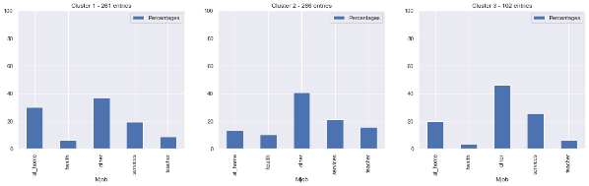
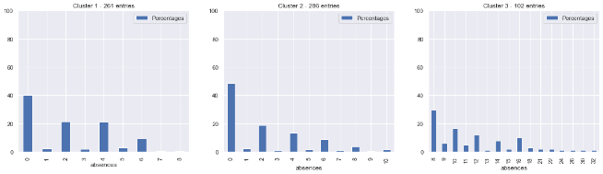
Kmeans (Mjob and absences)

Slide 18
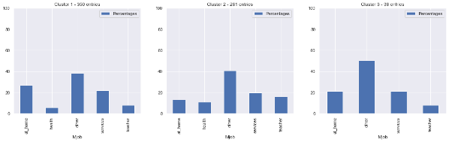
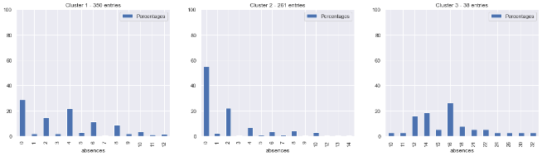
Hierarchical (Mjob and absences)

Slide 19
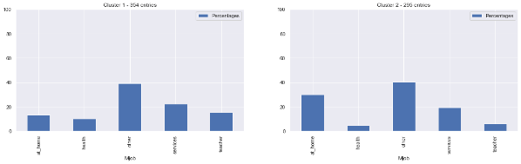
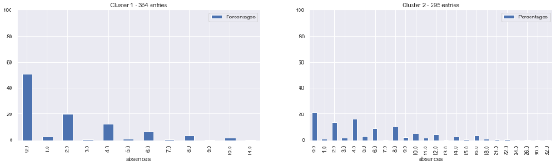
KPrototype (Mjob and absences)

Slide 20
Predictive Analytics
(Decision Tree)

Slide 21
Why Decision Tree?
Able to identify students who will pass/fail (binary)
Able to place students into bands (1-4)
Band 1 - Compulsory remedial (Lowest test score G3)
Band 2 - Recommended remedial
Band 3 - Optional remedial
Band 4 - Do not need remedial (Highest test score G3)
Splitting gives an indication of which predictors are better
Notes:
We used decision tree as we can see the variable that split the nodes, which let us know the variable importance. Decision tree also allows pruning and bagging and boosting to improve accuracy and quality. Decision Tree is also good at handling mixed data type. We also did two different responses, one is pass/fail and the other is splitting the response into different bands. Splitting the response gives us a better indication of which predictors are better.

Slide 22
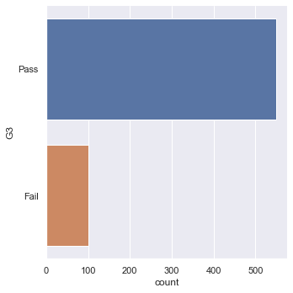


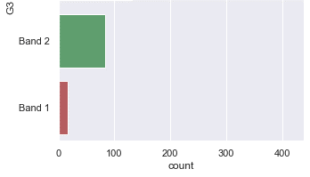
Binary VS Banded
Notes:
With this, we can see the breakdown of the different ways of handling the response variable G3.

Slide 23
Predictors
All Variables
Quantitative - (Numerical less Age)
Quantitative + Identified Variables
(Medu, Fedu, Mjob, studytime, failures, higher, internet, Dalc, Walc, Absences)
Notes:
We did 3 sets of decision trees using different predictors with 2 different output, pass/fail and banded.

Slide 24
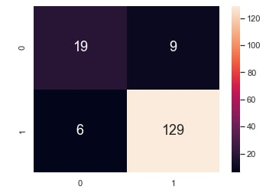
All Variables
(Pass/Fail)
All Var
Classification Accuracy: 0.907
TPR: 0.971 FPR: 0.370
Test Set
Notes:
As you can see, the classification accuracy for the decision tree for predicting binary output, using all the variables as predictors is 0.907.

Slide 25
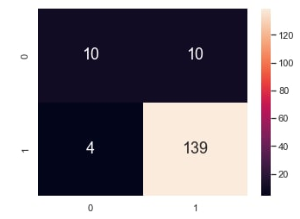
Quantitative
(Pass/Fail)
All Var
Classification Accuracy: 0.907
TPR: 0.971 FPR: 0.370
Quantitative
Classification Accuracy: 0.914
TPR: 0.937 FPR: 0.238
Test Set
Notes:
While the classification accuracy when we put only the quantitative variables less age as the predictor is 0.914

Slide 26
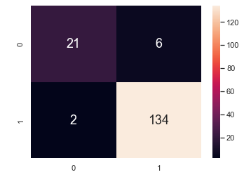
Prominent Variables
(Pass/Fail)
All Var
Classification Accuracy: 0.907
TPR: 0.971 FPR: 0.370
Quantitative
Classification Accuracy: 0.914
TPR: 0.937 FPR: 0.238
Prominent Var
Classification Accuracy: 0.951
TPR: 0.985 FPR: 0.222
Test Set
Notes:
And lastly the classification accuracy when using both Quantitative and the prominent variables that we got from clustering and correlation is 0.945.
With this, we can see that the decision tree which uses both quantitative + the prominent variables gives a higher classification accuracy with a low false positive rate.

Slide 27
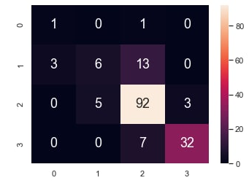
All Variables
(Banded)
All Var
Classification Accuracy: 0.803
Avg TPR: 0.628 Avg FPR: 0.103
Test Set
Notes:
As for the decision tree that splits the output into different bands, when we use all the variables as predictors, it gives us a classification accuracy of 0.803.
DTAll
Binary .907
Banded .803
DTNum
Binary .914
Banded .907
DTUseful
Binary .945
Banded .859

Slide 28
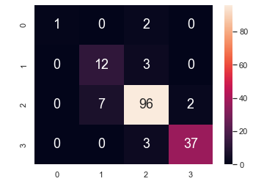
Quantitative
(Banded)
All Var
Classification Accuracy: 0.803
Avg TPR: 0.628 Avg FPR: 0.103
Quantitative
Classification Accuracy: 0.907
Avg TPR: 0.740 Avg FPR: 0.055
Test Set
Notes:
When we use only quantitative variables less age as predictors, it gives us a classification accuracy of 0.907

Slide 29
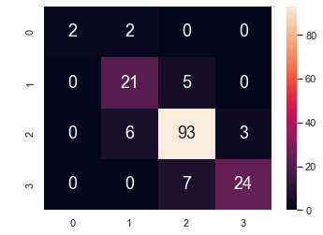
Prominent Variables
(Banded)
All Var
Classification Accuracy: 0.803
Avg TPR: 0.628 Avg FPR: 0.103
Quantitative
Classification Accuracy: 0.907
Avg TPR: 0.740 Avg FPR: 0.055
Prominent Var
Classification Accuracy: 0.859
Avg TPR: 0.748 Avg FPR: 0.069
Test Set
Notes:
And lastly, when we use only the quantitative less age + the prominent variables that we got from clustering and correlation as predictors, it gives us a classification accuracy of 0.859. However, the reason why it is lower might be because of the inaccurate grouping of band 3 and 4 but both still indicates that the student passes which explains the lower classification accuracy.
TPR = TP/(TP+FN) = 1.0, FPR = FP/(FP+TN) = 1.0

Slide 30
Accuracies
 | All Variables |  | Quantitative |  | Prominent Variables
 | Train | Test | Train | Test | Train | Test
Pass/ Fail | 0.959 | 0.908 | 0.955 | 0.914 | 0.951 | 0.951
Banded | 0.922 | 0.804 | 0.885 | 0.908 | 0.903 | 0.859
Notes:
This is the summary of all the previously mentioned values. We can clearly tell that the decision tree that used the prominent variables have a generally higher accuracy.

Slide 31
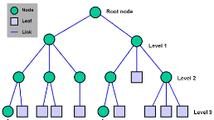
Splitting Node Variables
Mjob
At_home plays a detrimental part
Health and Service relates to better score
Medu & Fedu
Higher education relates to better score
Absences
For some, higher absences relate to better score
General trend where being absent relates to lower score

Slide 32
PARAMETER TUNING
BASELINE, NUM, CLUSTER ACC
XGBOOST AS ML

Slide 33
Prescriptive Analytics
(Outcome and insights)

Slide 34

Outcome and Insights
(Environmental Variable)
General
Mother’s Education (Medu)
Father’s Education (Fedu)
Failures
Absences
Actionable Variable
Mother’s Job (Mjob)
Study Time (studytime)
Higher Education? (higher)
Internet? (internet)
Daily Alcohol Intake (Dalc)
Weekly Alcohol Intake (Walc)
Notes:
Based on the decision trees used, we can tell how the different environment variables which excludes G1 and G2 affects our response variable G3. With this, we split the environment variables into general variables and actionable variables. The general variables are variable that we cannot change, while the actionable variables are variables that we can change. From this we can see that parents education plays a part in whether a child will score well in their exam. We could also infer that students who want to go to a higher education, would generally do better.

Slide 35


Recommendation
Recommended Actions for the School
Mother taking up job or volunteer
Increase study time
Promote higher education and education outlook
Internet access support
Reduce alcohol consumption
Notes:
Some recommendations that we can give is, firstly, the school could encourage the students mother to take up a job or volunteer outside. Also, the school could also start promoting higher education and improve the education outlook of students. Parents should also help to monitor their children study time and alcohol consumption rate too. Both the school and the parents should support online learning more to help better facilitate the students’ learning.

Slide 36
Thank you

